Slide 1


filter buddy
Designing Word Filter Tools for Creator-led Comment Moderation
Shagun Jhaver, Quanze Chen,
Detlef Knauss, Amy Zhang

Slide 2

Caution: disturbing content
Notes:
Before I begin, I want to caution that some of the slides in this talk contain offensive language

Slide 3
Background
Notes:
Let me begin by providing some background for this work.

Slide 4

Content Creators
Notes:
This research is focused on serving content creators on platforms like YouTube, TikTok and Twitch.
Creators on these platforms not only have to write, produce and edit their content, they are also responsible for removing inappropriate comments posted on their channels.

Slide 5
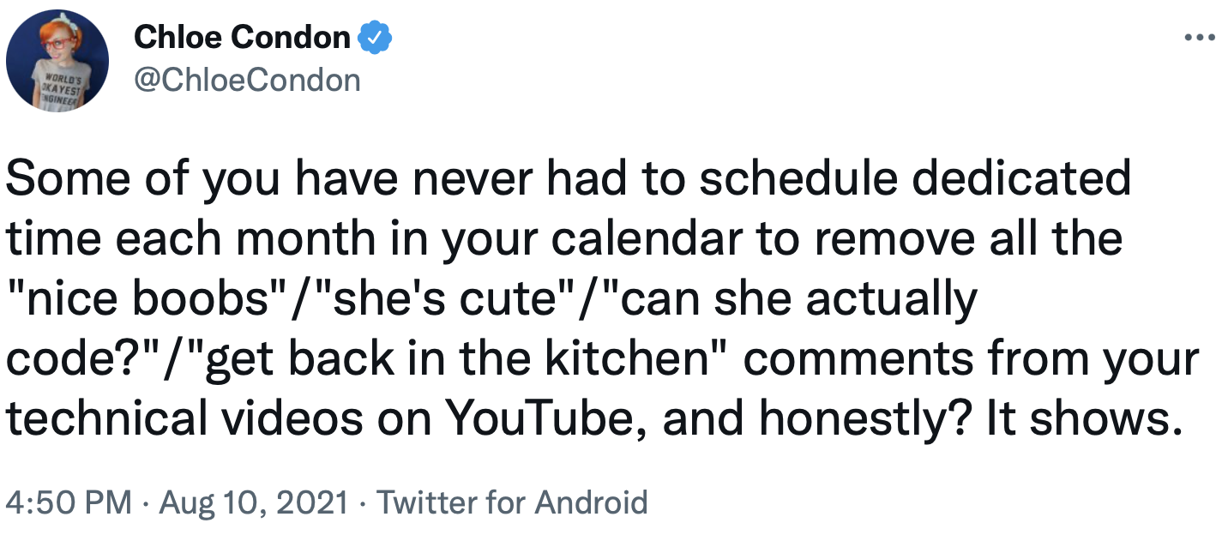
Notes:
Creators, esp. those belonging to marginalized groups, often experience stalking, harassment and online threats and feel a need to engage in comment moderation.
But as their channels grow, it becomes difficult for creators to review all their comments by themselves, and some automation becomes necessary.
As a result, creators have long requested for powerful moderation tools that can reduce their workload.

Slide 6
Goals
Investigate the design of moderation tools
Esp. creators from marginalized groups
Surface unmet information needs
Build a system that addresses these needs
Evaluate what we built
Notes:
Given this context, the goals of this research were to investigate the design of moderation tools aimed at content creators.
We focused especially on creators belonging to marginalized groups, because they face disproportionate harassment.
Through this investigation, we wanted to surface the unmet information and moderation needs of content creators.
Next, we wanted to build a system that begins to address these needs.
And finally, we wanted to evaluate what we built to inform the future design of automated moderation systems.

Slide 7
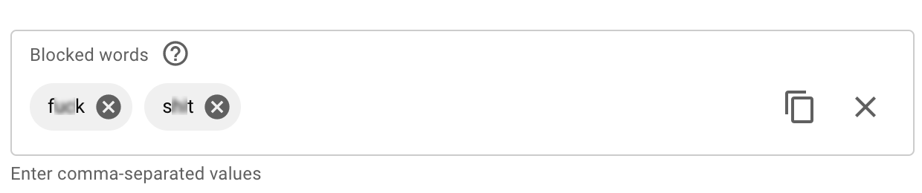
Word filter tool on YouTube
Notes:
As creators, one of the most commonly available tools to automate moderation is word filters.
These are tools in which users can configure a list of phrases and comments containing any of those phrases are automatically removed.

Slide 8
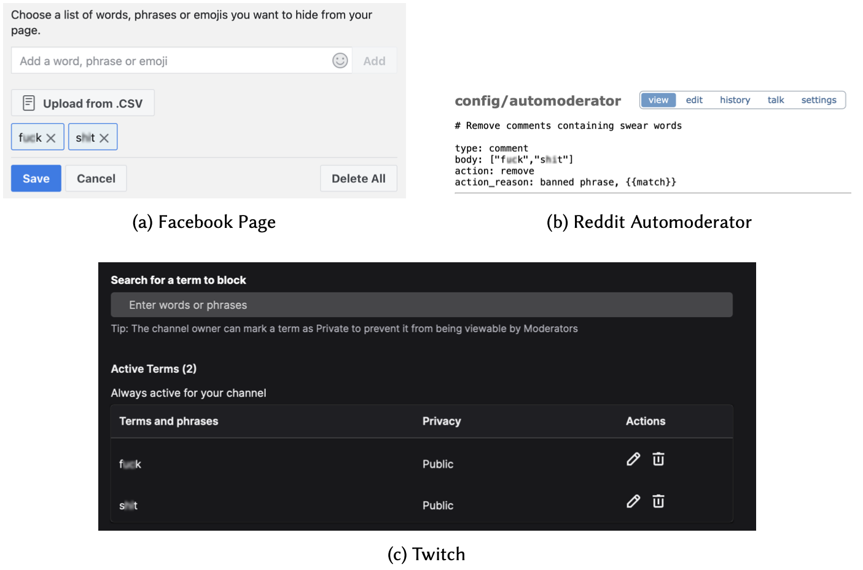
Word filter tools
Notes:
While these word filter tools are available on many platforms like YouTube, Facebook, Reddit and Twitch, they usually present very rudimentary features.
So, in this study, we focus our need-finding and design exploration around word filter tools.

Slide 9
Need-finding & System design
Notes:
We first identified the moderation needs of creators who use word filter tools

Slide 10
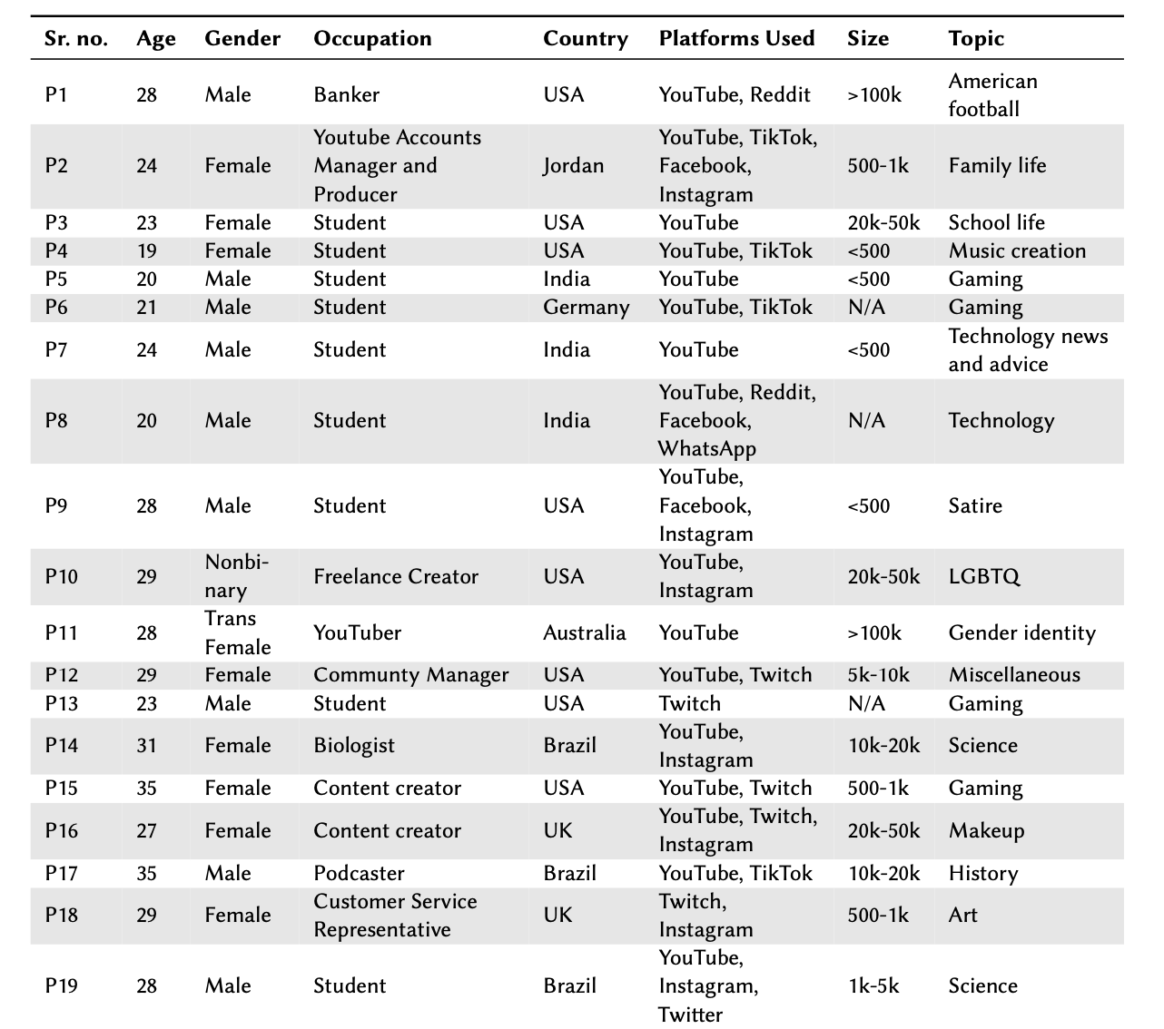
Need-finding
Notes:
For this, we interviewed 19 creators who use word filter tools on YouTube, Twitch or TikTok, and analyzed our interview data using interpretive qualitative analysis.

Slide 11


Need-finding interviews
System Features
Creators’ Needs
filter buddy
Notes:
Through these interviews, we identified creators’ needs and then built a new system called FitlerBuddy, that
augments word filter tools with features to support better authoring, maintenance, and auditing of word filters.
To begin with, we have implemented FilterBuddy for YouTube.
Next, let me discuss how FilterBuddy features address the specific needs of creators

Slide 12
Need 1: Separately group different categories of inappropriate comments
Better organization
Easier review and search
Notes:
During our needs analysis, our participants told us that instead of a single box to configure all their word filters, they wanted to separately group different categories of inappropriate comments because it would lead to better organization of their word filters and allow an easier review and search for them.

Slide 13
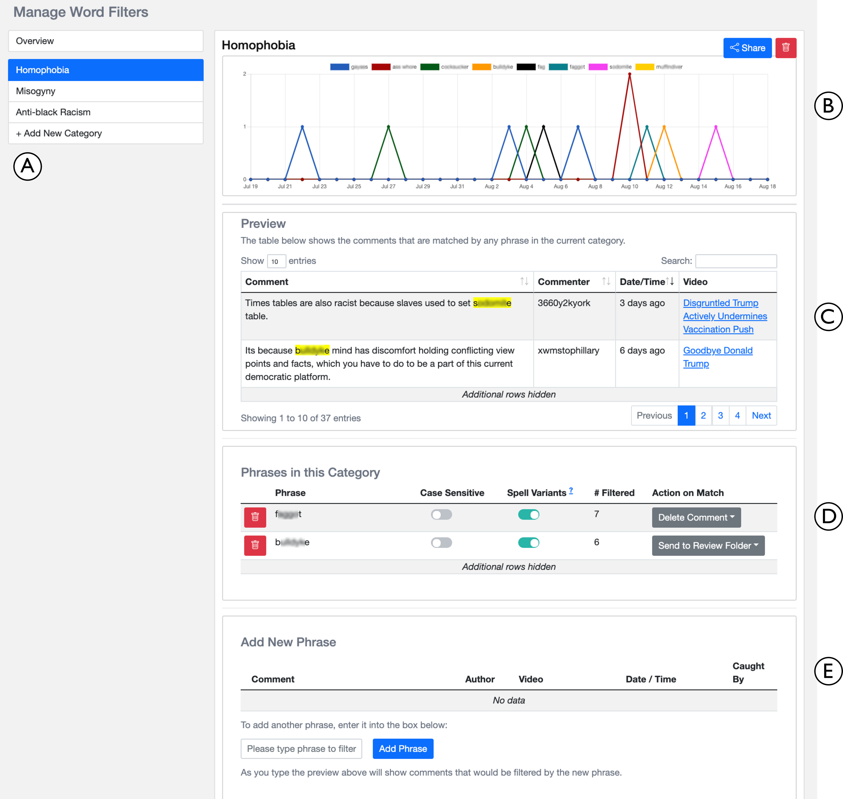
Notes:
To address this need, FilterBuddy allows creators to organize their word filters in several different categories.

Slide 14
Notes:
To address this need, FilterBuddy allows creators to organize their word filters in several different categories.
These are 3 examples of custom categories that a participant may configure in FilterBuddy

Slide 15
Need 2: Have a few default categories
Curated categories like sexism and racism
Avoid creating commonly needed categories from scratch
“Having the base list is perfect for the creator, because they don’t even have to like spend the time…brewing over what words might be used towards them, which is like the most messed up thing to have to think about in the first place” – U4
Notes:
Participants, especially those belonging to marginalized groups, wanted FilterBuddy to have a few curated categories available by default,
because they wanted to avoid creating commonly needed categories like sexism and racism from scratch.

Slide 16
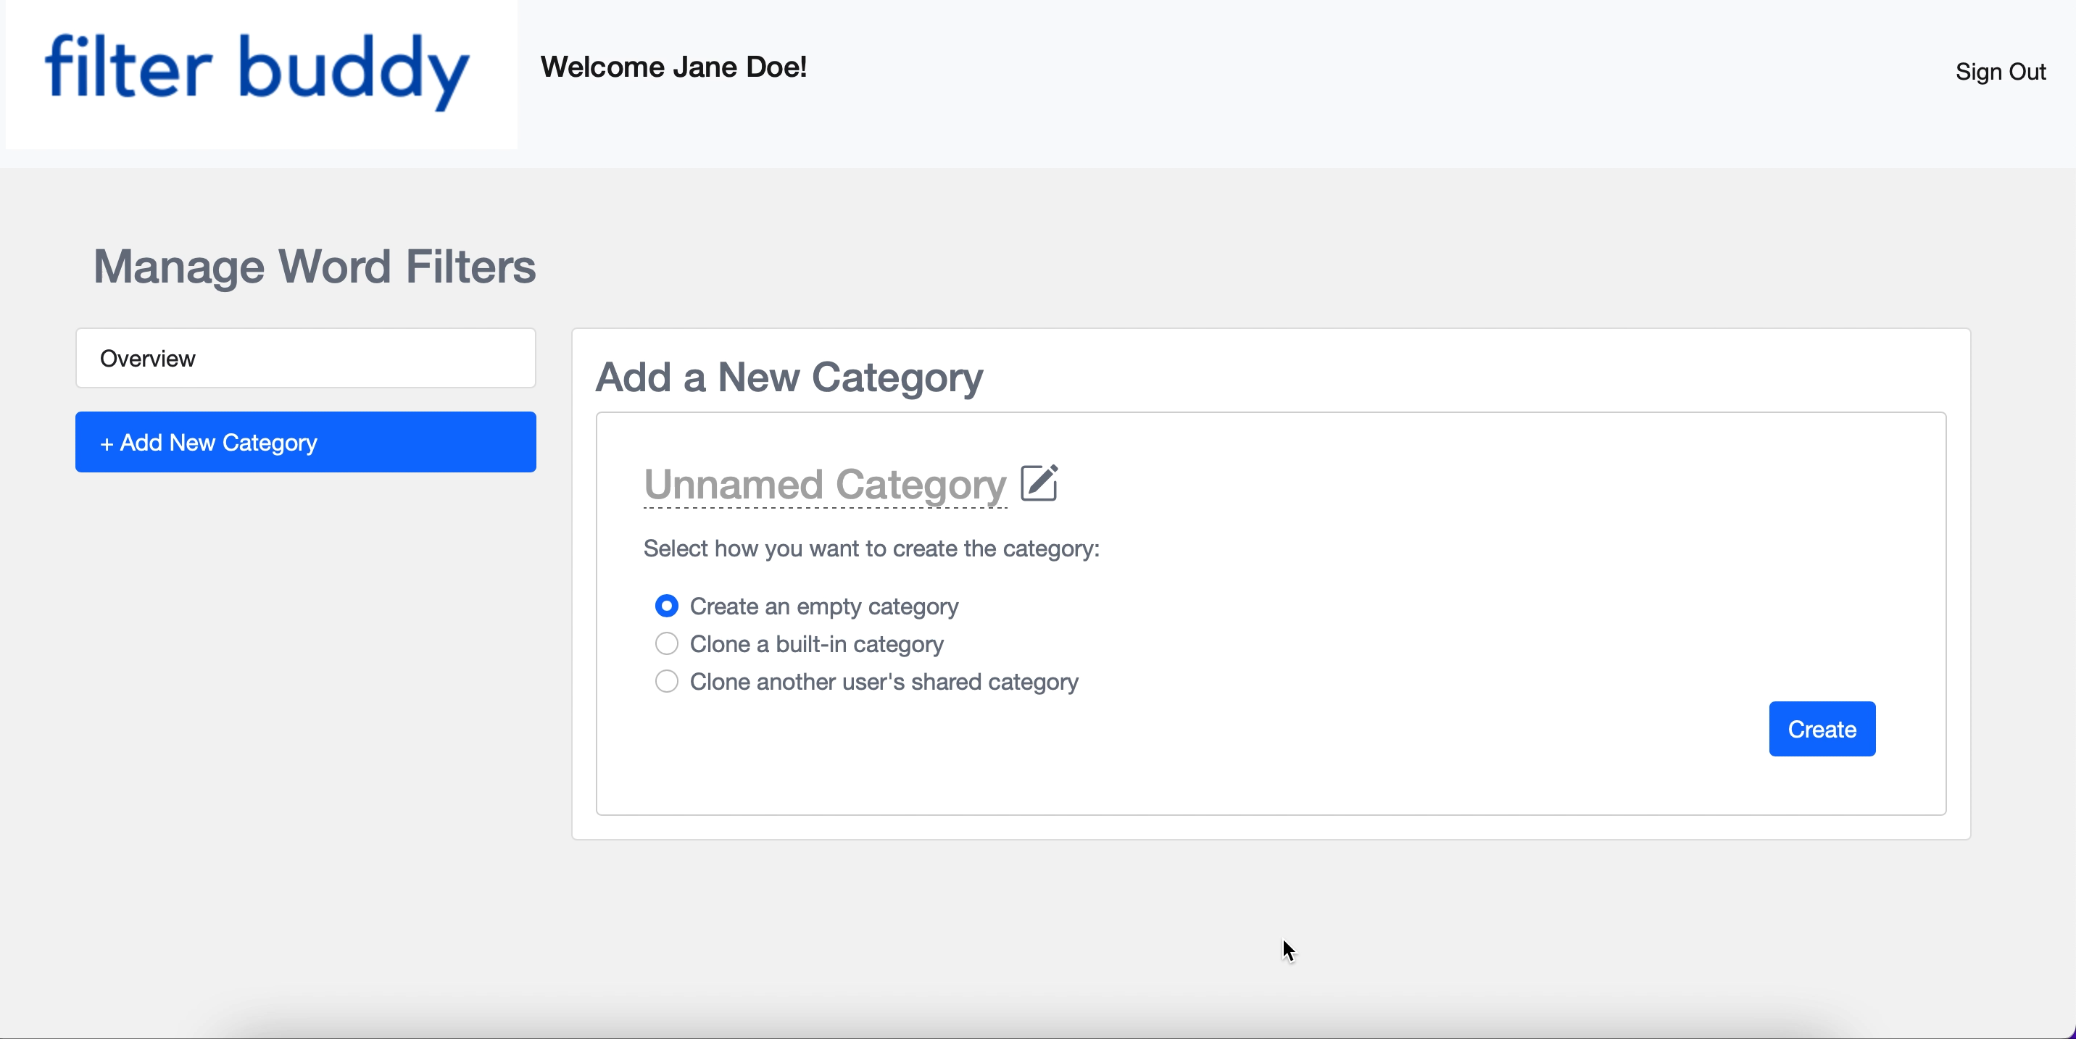
Notes:
[Pause]
To address this need, users can clone one of the built-in categories that FilterBuddy provides such as homophobia, physical violence, or sexual violence.
We have created filters for these categories ourselves based on prior literature.
Here, we are seeing how a user imports the built-in homophobia category.
On importing, users are redirected to a new homophobia category page that is already populated with many carefully curated homophobic keywords.
Users can subsequently edit this category to match their preferences.

Slide 17
Need 3: Seeing examples of matching comments while configuring filters
Improve understanding of how each word filter would perform
Notes:
Participants also wanted to see examples of matching comments while configuring filters because they felt it would improve their understanding of how each word filter would perform, if it is configured

Slide 18
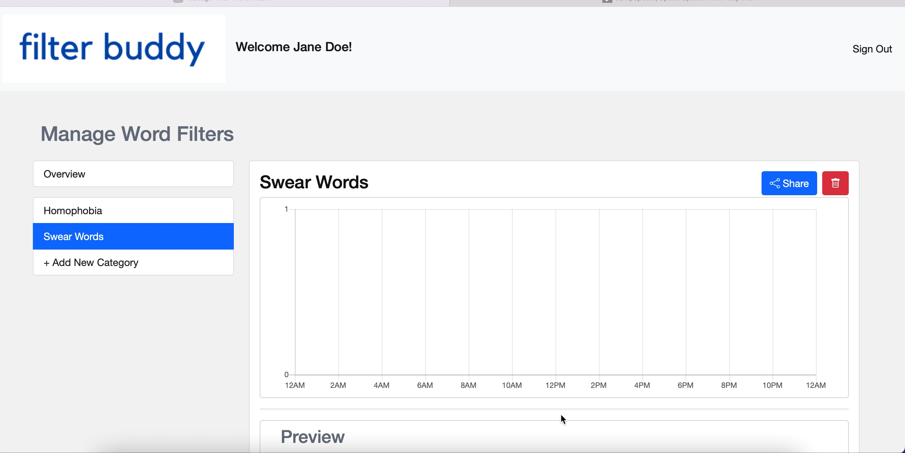
Notes:
[Pause]
To address this need, users can enter a phrase in this ‘Add New Phrase’ box. This automatically populates all the comments previously posted on the user’s channel that contain this phrase. Reviewing these comments allows users to make an informed decision on whether they want to add this phrase as a word filter. Users can choose whether they want the system to catch the spelling variants of each word filter. They can also decide what actions they want to take on comments caught by each word filter.

Slide 19
Need 4: Getting an overview of word filters’ actions
Interested in reviewing the temporal performance of configured categories.
“Obviously, something like adding word filters could potentially have a negative impact if 75% of your viewers are saying a phrase that you filtered out. So, it would be cool to have statistics for stuff like that.” – P9
Notes:
Finally, participants wanted to get an overview of word filters’ actions. They were especially interested in reviewing the temporal performance of their configured categories.

Slide 20
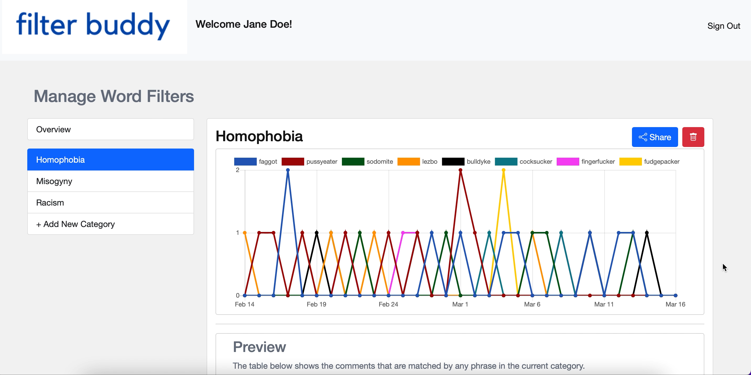
Notes:
To serve this need, on each category page, we present a graph that tells users how different phrases configured in that category caught comments on their channel over the last thirty days.
We also show the users a preview table of all the comments caught by that category.
Additionally, on the Overview page, we show the users a graph of comments caught by each category.

Slide 21
Evaluation
Notes:
After building FilterBuddy, we evaluated it by conducting a user study with 8 YouTube creators.

Slide 22
User Study
Interviewed 8 YouTube creators
Asked participants to “think aloud” while exploring FilterBuddy features
Interpretive qualitative analysis
Notes:
We asked participants to explore FilterBuddy features and author filters over their comments while providing us qualitative feedback

Slide 23
Insights
Appreciative of greater automation
Show resistance to solely ML-based approaches
Requested additional defensive mechanisms to reduce incorrect removals
Liked the ability to share their filters and build off of filters created by others
Devised many use cases for the tool:
Filtering for positive feedback
Better understanding audiences
Notes:
Through this study, we found that users were appreciative of greater automation that FilterBuddy enables.
(2) When we asked participants to compare FilterBuddy to something machine learning based, they showed
resistance to replacing the rule-based configurations of this tool with solely ML-based approaches
(3) Some participants requested additional defensive mechanisms to reduce incorrect removals made by FilterBuddy.
(4) Many participants liked the ability to share their filters with other creators and build off of filters created by others.
(5) We were also surprised to find that many participants devised use cases for this tool that went beyond removing inappropriate comments. This included finding new collaborators, filtering for positive feedback, and better understanding their audiences.

Slide 24
Takeaways
Notes:
Let me highlight now some of the key takeaways of this work.

Slide 25
Design Implications
Creators are deeply invested in retaining control
Sensible design defaults can help with minimizing manual effort
Need for advanced analytic and visualization tools
Notes:
First, we found that creators are deeply invested in retaining control over their moderation operations.
Considering this, we argue that sensible design defaults can help creators achieve this goal while minimizing the manual effort of setting up granular filters
We also found that there is an urgent need for advanced analytic and visualization tools that facilitate discovery of unusual temporal and topical trends in creators’ comments, and HCI
researchers can make valuable contributions in this space.

Slide 26
Role of Different Stakeholders
Platforms
Foster an ecosystem of mod tools
Minority support groups
Curate and publicize word filters
Policymakers
Mandate platforms to provide mod tools
Notes:
We also examined how other stakeholders can assist content creators with moderating their comments.
First, platforms could go beyond providing API access to their data and dedicate technical and human resources to foster an ecosystem of third-party tools such as FilterBuddy.
Second, minority support groups can use their domain expertise and influence to curate and publicize appropriate lexicons for tools like FilterBuddy.
And finally, policymakers can empower content creators by mandating that large platforms like YouTube and TikTok must provide creators with moderation mechanisms that let them efficiently manage their channel’s comments.

Slide 27


filter buddy
Designing Word Filter Tools for
Creator-led Comment Moderation
Shagun Jhaver, Quanze Chen, Detlef Knauss, Amy Zhang
Contributions
We present FilterBuddy, a new system to support authoring, maintenance and auditing of word filters, a key moderation tool.
Our design exploration highlights the tradeoffs between control over the operation of moderation tools and manual effort required for configuring.
We propose how platforms, third-party organizations, advocacy groups and policymakers can assist creators in improving online spaces.
Code: https://github.com/Social-Futures-Lab/FilterBuddy
Presented by
Shagun Jhaver
@shagunjhaver
Supported by
Notes:
Thank you, and we invite you to build on top of FilterBuddy. I will be happy to take some questions now.

